Slide 1

Fresno Compact
October 2, 2020
Fresno K-16 Collaborative Executive Director, Karri Hammerstrom
Notes:
Over the course of the next decade, the Fresno K-16 Collaborative aims to reach the following impact targets:
•Increase production of post-secondary graduates in high growth, high wage disciplines that address the labor market gap.
•Reduce racial and ethnic economic disparities
•Improve graduation rates and shorten time to completion for Associate’s and Bachelor's

Slide 2
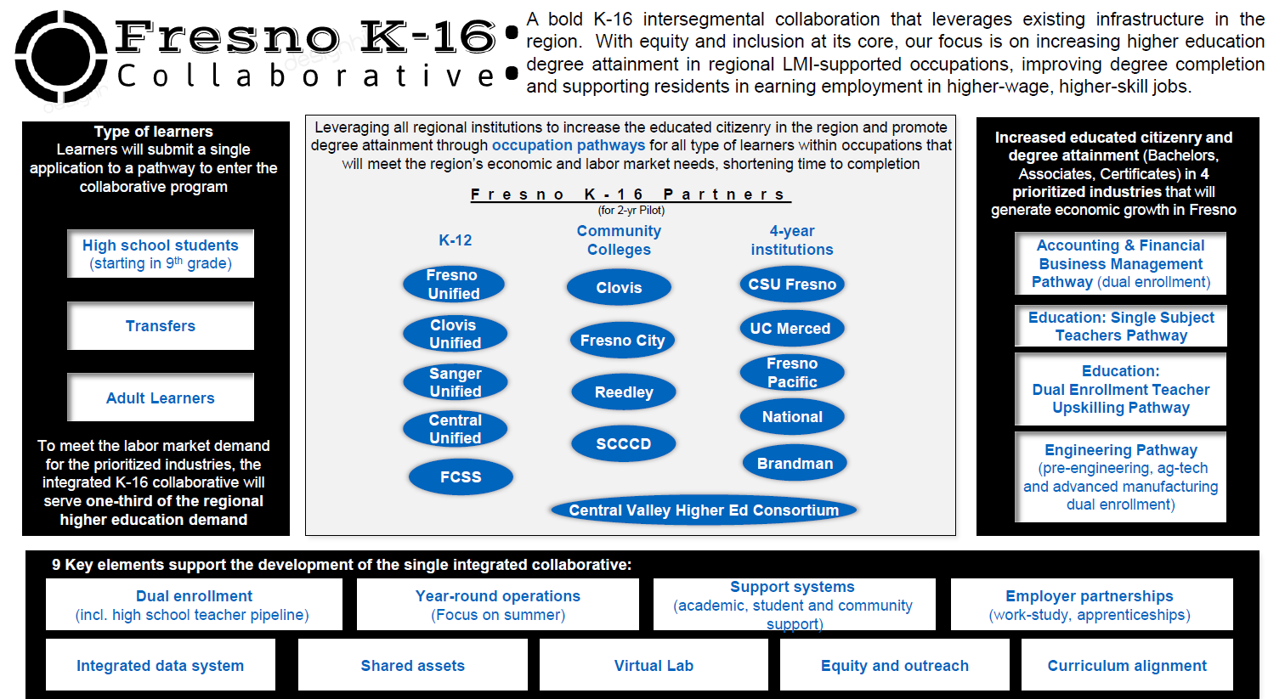

Slide 3
What is the Fresno K-16 Collaborative?
Regional education leaders working with the Governor’s Council on Post-Secondary Education and with support by College Futures Foundation, the Fresno K-16 Collaborative emerged as a 2-yr pilot program designed to close equity gaps for the Fresno region’s racially and socioeconomically diverse student population.

Slide 4
What is the Fresno K-16 Collaborative?
Bold K-16 intersegmental collaboration focused on laying the
foundation with dual enrollment pathways to
systemically and sustainably address equity and inclusion of
our most vulnerable student populations by:
  improving socioeconomic mobility with increased educational attainment levels
  increasing employability in high-demand, living wage jobs
  lowering the poverty rate
Notes:
With dual enrollment pathways, the pilot work is intended to create an integrated, replicable, regional K-16 educational system foundation to systemically and sustainably address race equity and inclusion of our most vulnerable student populations by:
improving socioeconomic mobility with increased educational attainment levels
increasing employability in high demand, living wage jobs
lowering the poverty rate

Slide 5

Types of Learners
High School Students
Transfer Students
Adult Learners

Slide 6
Four K-16 prioritized pilot pathways focused on dual enrollment
Accounting and Financial Management (DE, certificates and Associate, Bachelor’s degree)
Engineering (DE, Associates, Bachelor’s)
Education - Single Subject Teachers (DE, Bachelor’s and teacher credentials)
Education – Dual Enrollment Teachers (Upskilling - Master’s degrees for high school teachers to teach dual enrollment)

Slide 7
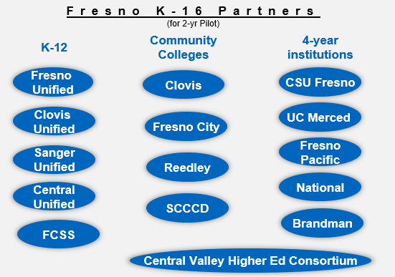
Fresno K-16 Collaborative Partners for the initial two-year pilot
Notes:
The Fresno K-16 Collaborative Executive Steering Committee members are:
• Fresno City College: President Carole Goldsmith, Chair
• Fresno State: President Joe Castro, Vice Chair
• Fresno Unified School District: Superintendent Bob Nelson
• UC Merced: Chancellor Juan Sánchez Muñoz
• State Center Community College District: Chancellor Paul Parnell
• Clovis Community College: President Lori Bennett
• Fresno Pacific University: President Joe Jones
• Reedley College: President Jerry Buckley
• Clovis Unified School District: Superintendent Eimear O’Farrell
• Sanger Unified School District: Superintendent Adela Jones
• Central Unified School District: Superintendent Andrew Alvarado
• Fresno County Superintendent of Schools: Superintendent Jim Yovino
• Brandman University: Chancellor Gary Brahm
• National University: President David Andrews
• Central Valley Higher Education Consortium: Executive Director Ben Duran

Slide 8
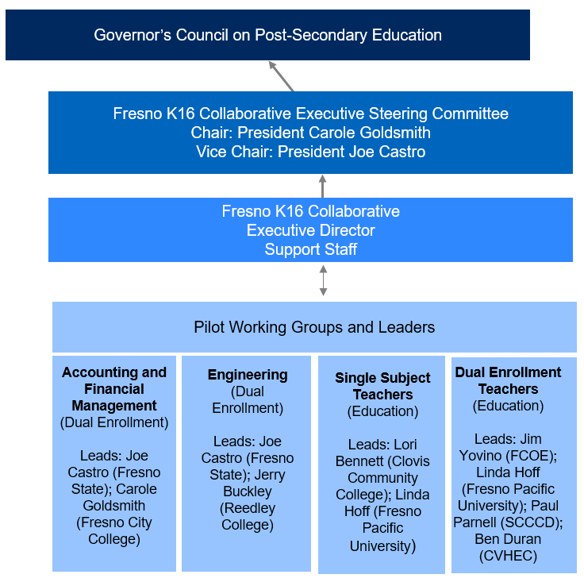
Fresno K-16 Collaborative Organizational Structure
Notes:
The Fresno K-16 Collaborative Executive Steering Committee members are:
• Fresno City College: President Carole Goldsmith, Chair
• Fresno State: President Joe Castro, Vice Chair
• Fresno Unified School District: Superintendent Bob Nelson
• UC Merced: Chancellor Juan Sánchez Muñoz
• State Center Community College District: Chancellor Paul Parnell
• Clovis Community College: President Lori Bennett
• Fresno Pacific University: President Joe Jones
• Reedley College: President Jerry Buckley
• Clovis Unified School District: Superintendent Eimear O’Farrell
• Sanger Unified School District: Superintendent Adela Jones
• Central Unified School District: Superintendent Andrew Alvarado
• Fresno County Superintendent of Schools: Superintendent Jim Yovino
• Brandman University: Chancellor Gary Brahm
• National University: President David Andrews
• Central Valley Higher Education Consortium: Executive Director Ben Duran

Slide 9
Design Principles
  Be a bold K-16 intersegmental collaboration that leverages existing infrastructure in the region
  Be student-centered, ensuring success for all student throughout K-16, and addressing pain points and barriers for the most vulnerable population(s)
  Demonstrate significant strides to close the equity gap
  Eliminate institutional and transitional barriers in the delivery of K-16 education
  Address capacity, expanding access to higher education at the regional level
  Shorten time to completion and increase completion rates for post-secondary degrees
  Align with the region’s economic and labor market needs and promote a culture of innovation
  Incentivize students to enter and stay in the regional labor market
  Develop a program process that is replicable in regions facing similar problems

Slide 10
9 Key Elements
Dual enrollment (including high school teacher pipeline)
Year-round operations (focus on summer)
Support systems (academic, student & community support)
Employer partnerships (work-study, apprenticeships)
Integrated data system
Shared assets (physical & personnel)
Virtual Lab
Equity and outreach (race equity & inclusion North Star for all work; creating connectivity with K12, CCC, 4yr and DRIVE, and other CBO efforts)
Curriculum alignment

Slide 11
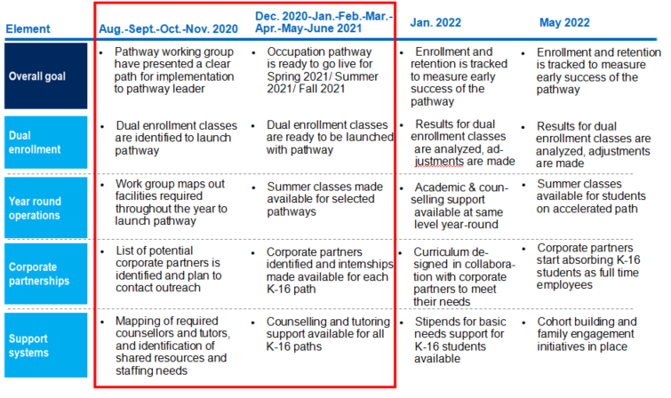
What will success look like?…

Slide 12
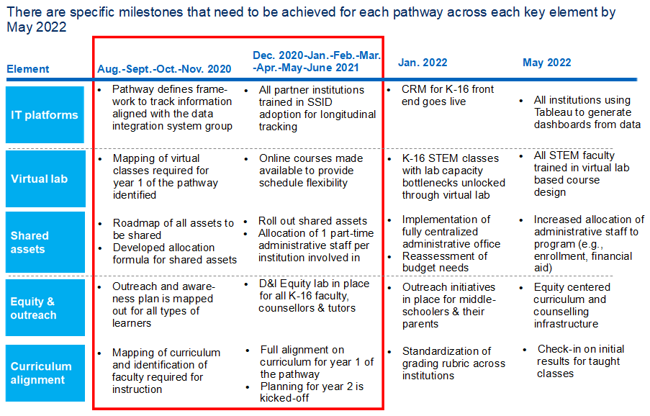
What will success look like?…

Slide 13

Notes:
Shout out to those who were reviewers! Each proposal had a min of 6 reviewers…..

Slide 14
Collaborative Partner Pilot Pathway Projects
70
539+

Slide 15

Pilot Pathway Working Groups
  Accounting and Fiscal Management/ Dual Enrollment
    Winter/Summer Bridge Type Programs Workgroup
  Engineering/ Dual Enrollment
  Education – Single Subject Teachers/ Dual Enrollment
  Education – Upskilling Masters for Dual Enrollment
  C2C’s P16 Data Collaboration
  Adult Learners
  Race, Equity, Inclusion
  Marketing Outreach
Notes:
Want to participate?

Slide 16
Thank you! Questions?
Karri Hammerstrom
khammerstrom@csufresno.edu
(559) 916-4425

